Slide 1

Library Management System
Welcome to the presentation of our Library Management System, designed to efficiently manage library operations and provide a streamlined experience for both administrators and students.
Presented By :
Muhammad Hammad 56765
Muhammad Aqeel 56983
Ahmed Tariq 56274

Slide 2
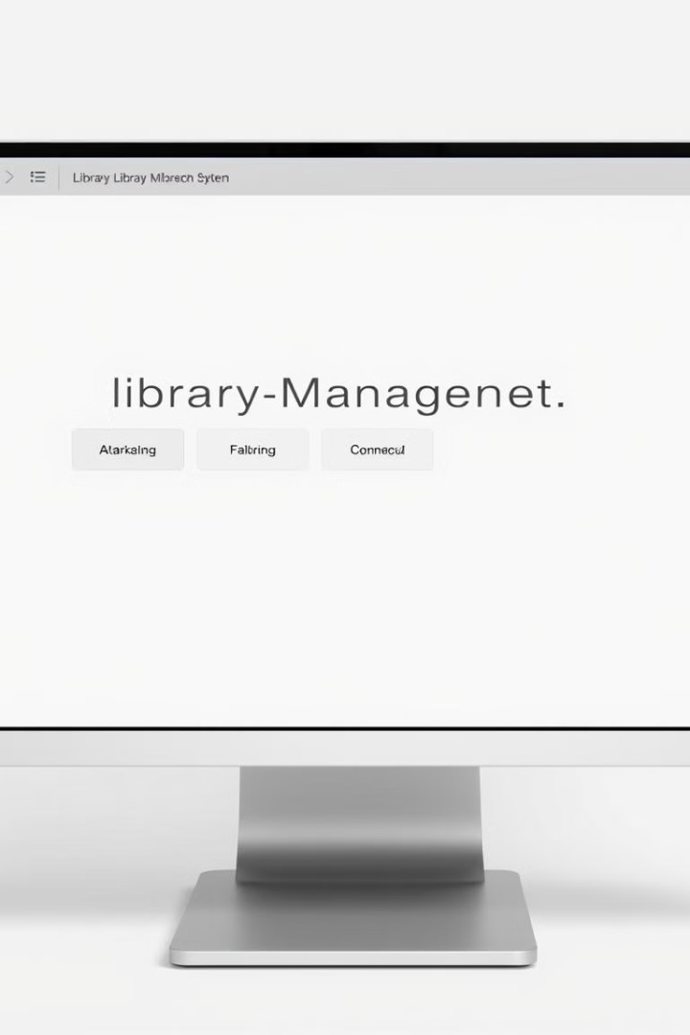
Introduction
1
Streamlined Operations
2
CONCEPT
The Library Management System offers a user-friendly interface for managing library operations, simplifying tasks for both administrators and students.
The system leverages modern data structures like hash tables and linked lists to optimize performance, ensuring fast and reliable book lookups and management.
3
Modern Approach
Our system integrates key features for managing book inventory, student records, borrowing and returning processes, and more, to ensure a well-organized library.

Slide 3
Data Structures Concept
Hash Table (k % n)
Linked List
The hash table uses a hash function k % n,where k is the key (book ID) and n is the table size, ensuring efficient book lookup.
Linked lists are used for collision handling in the hash table and for managing the list of books.
The advantage is dynamic memory allocation, making it easy to add or remove elements without a predefined size limit.
The advantage is fast search, insertion, and deletion operations with an average complexity of O(1).

Slide 4
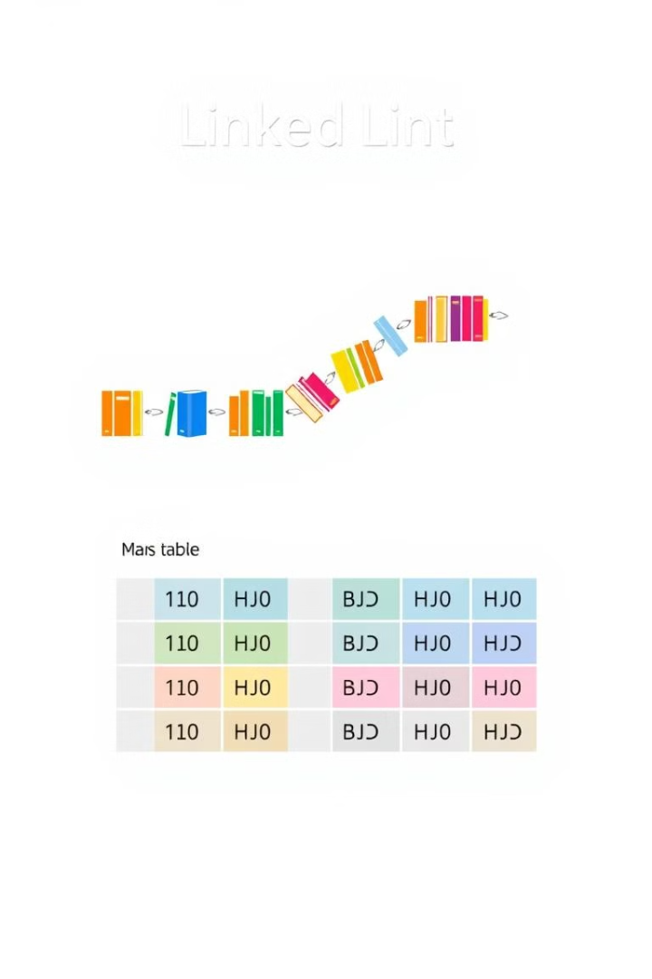
Advantages of Linked Lists and Hash Tables
1
1. Flexibility
2
2. Ease of Modification
Linked lists adapt to varying data sizes, avoiding wasted memory.
Insert or delete elements efficiently, essential for managing library records.
3
3. Search Efficiency
Hash tables minimize search time, crucial for locating
books by ID.

Slide 5

Objectives
User-Friendly Interface
Streamlined Processes
The system provides a simple and intuitive interface for both administrators and students, making it easy to manage library operations and access resources.
The system streamlines borrowing, returning, and membership processes, minimizing wait times and ensuring a smooth experience for library users.
Secure Access Control
The system implements secure access control with distinct roles for administrators and students, ensuring data security and appropriate user permissions.

Slide 6

Key Features of the Library System
Admin Features
Student Features
Add, edit, and delete books and students, manage membership requests, search for books, and view borrowed books.
Borrow and return books, search for books, and view their borrowing books.
General User Features
View available books and request registration.

Slide 7
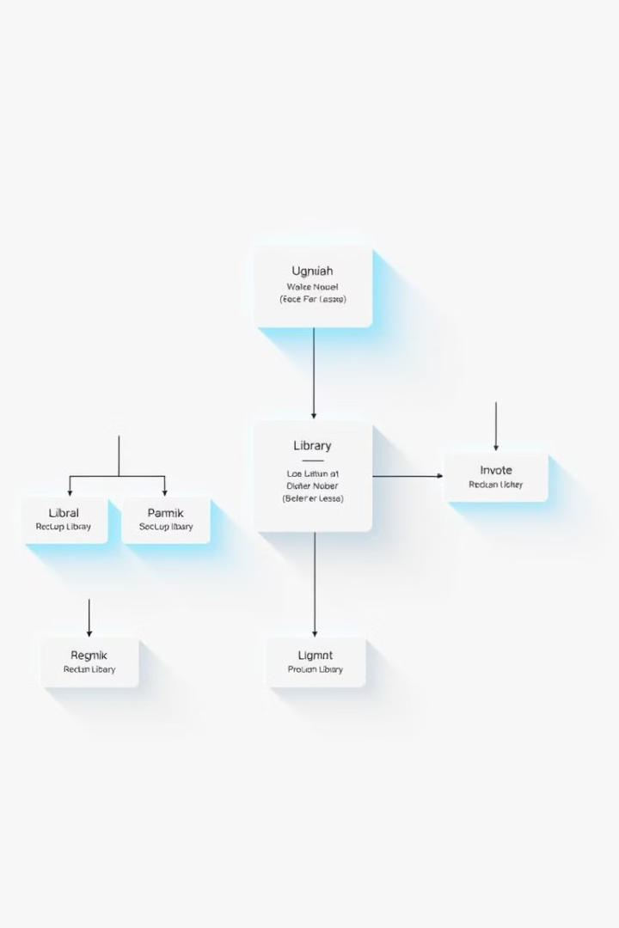



Main Classes
Book Class
Represents a book with attributes like ID, title, author, and availability.
Student Class
Stores student details, membership status, and borrowed book list.
LibrarySystem Class
Manages overall library operations and interacts with other classes.

Slide 8




Technologies Used
Programming Language
Data Structures
File Handling
C++ is chosen for its efficiency, versatility, and support for object-oriented programming, allowing for a structured and modular codebase.
Linked Lists and Hash Tables are employed to manage book data, student information, and borrowing records, optimizing system performance.
Streamlined file I/O operations ensure
persistent storage of book.
Features :
1
Login System
The system distinguishes between Admin and Student roles, providing access to relevant
features and functionalities based on user credentials.
2
Admin Interface
The admin interface provides a range of tools for managing books, students, memberships, and system configurations.
3
Student Interface
The student interface offers functionality for browsing the book catalog, borrowing and returning
books, and managing personal information.
4
File Management
The system handles the book data .

Slide 9

Conclusion
Our Library Management System provides a reliable and efficient solution for managing library resources, fostering better organization and improved user experiences for both students and administrators.

